Slide 1
UNIT 2
Intelligent Agents and Problem solving

Slide 2
Introduction to Agents and Environment
An Agent is anything that can perceive its environment through sensors and acts upon that environment through effectors.
A human agent has sensory organs such as eyes, ears, nose, tongue and skin parallel to the sensors and other organs such as hands, legs, mouth for effectors.
A robotic agent replaces cameras and infrared range finders for the sensors and various motors and actuators for effectors.
A software agent has encoded bit strings as its programs and actions.

Slide 3
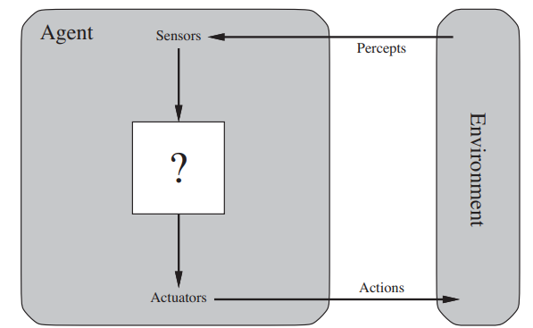

Slide 4
Types of Agents
Agents can be grouped into five classes based on their degree of perceived intelligence and capability. All these agents can improve their performance and generate better action over the time. These are given below:
Simple reflex agents
Model-based reflex agents
Goal-based agents
Utility-based agents
Learning Agent

Slide 5
Simple reflex agents
The simple reflex agents are the simplest agents. These agents take decisions on the basis of the current percept and ignore the rest of the percept history.
These agents only succeed in the fully observable environment.
The simple reflex agent does not consider any part of precepts history during their decision and action process.
The simple reflex agent works on condition-action rule which means it maps the current state to action. Such as a Room cleaner agent, it works only if there is dirt in the room.

Slide 6
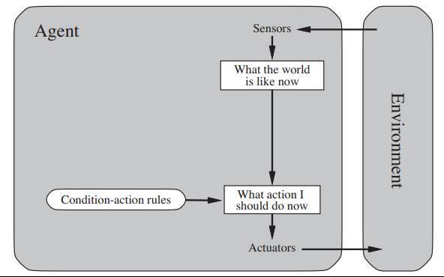

Slide 7
Model-based reflex agents
A Model-based Agent maintains an internal state to keep track of parts of the environment that are not directly observable.
Used in partially observable environments.
Stores information from previous precepts.
Updates its internal state continuously.
Uses a model of the world to predict changes in the environments.
Considers how its own actions affect the environment.

Slide 8
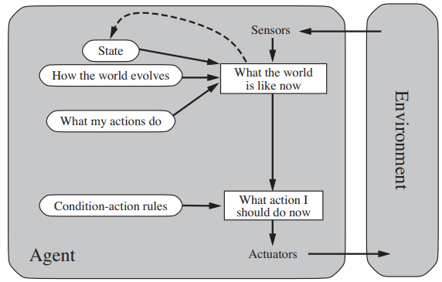

Slide 9
Goal-based Agents
A Goal-Based Agent chooses actions based on the goals it wants to achieve. It considers the current state, possible future states, and selects the action that leads to the desired goal.
Uses goal information to make decisions.
Evaluates the outcomes of different actions.
Can plan a sequence of actions to reach a goal.
More flexible than reflex agents because goals can be changed easily.

Slide 10
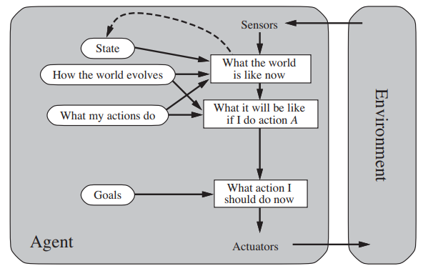

Slide 11
Utility-based agents
Goals alone are not always sufficient to make the best decision.
A Utility-Based Agent compares different possible outcomes and chooses the one with the highest utility (best overall result).
Utility represents how desirable or beneficial a state is for the agent.
Example: A taxi agent may choose a route that is not only fast but also safe, reliable, and economical.

Slide 12
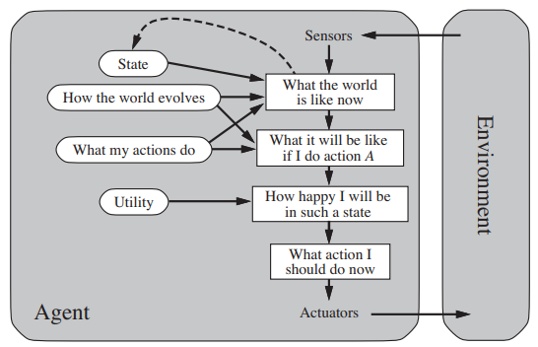

Slide 13
Learning agents
Learning Agent is an intelligent agent that learns from experience and feedback and improves its performance over time.
A learning agent has four main components:
Performance Element – selects actions.
Learning Element – improves the agent’s performance.
Critic – evaluates performance and provides feedback.
Problem Generator – suggests new actions for exploration and learning.

Slide 14
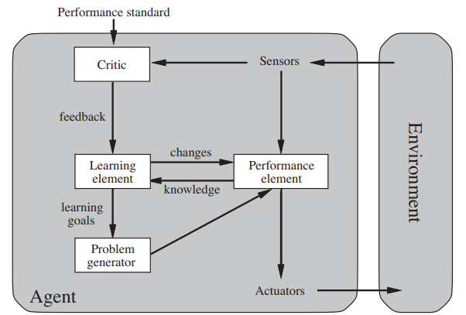

Slide 15
Nature of Environment and Agents
The environment is the external world in which an AI agent operates and interacts.
An agent perceives information through sensors and performs actions using actuators.
The behavior of the environment depends on the available information and how the environment changes over time.
Environments can be classified based on observability, uncertainty, and decision-making structure.

Slide 16
Types of Environment
Fully Observable vs Partially Observable
Deterministic vs Stochastic
Episodic vs Sequential
Static vs Dynamic
Discrete vs Continuous
Single-Agent vs Multi-Agent

Slide 17
1. Fully Observable vs Partially Observable
An environment is fully observable when the agent can access all the information needed to make decisions, whereas it is partially observable when the agent has limited or incomplete information about the environment.
2. Deterministic vs Stochastic
An environment is deterministic when the same action always produces the same result, whereas it is stochastic when the result may vary due to uncertainty or randomness.

Slide 18
3. Episodic vs Sequential
An environment is episodic when each action is independent of previous actions, whereas it is sequential when current actions affect future decisions and outcomes.
4. Static vs Dynamic
An environment is static when it does not change while the agent is making decisions, whereas it is dynamic when it can change during decision-making.

Slide 19
5. Discrete vs Continuous
An environment is discrete when it has a finite number of distinct states and actions, whereas it is continuous when states, actions or time can change continuously.
6. Single-Agent vs Multi-Agent
An environment is single-agent when only one agent operates in it, whereas it is multi-agent when multiple agents interact, cooperate or compete with each other.

Slide 20
Examples
Chess: Fully Observable, Deterministic, Sequential, Static, Multi-Agent.
Self-Driving Car: Partially Observable, Stochastic, Sequential, Dynamic, Multi-Agent.

Slide 21
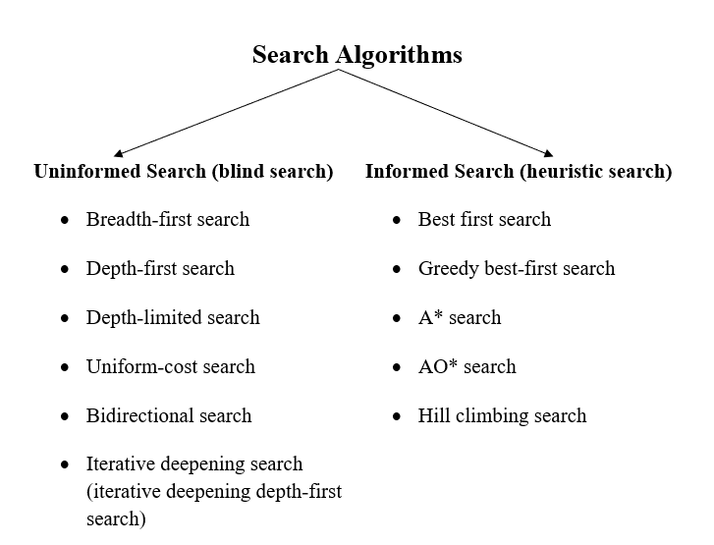

Slide 22
Breadth-first search
Breadth-first search is the most common search strategy for traversing a tree or graph. This algorithm searches breadthwise in a tree or graph so it is called breadth-first search.
BFS algorithm starts searching from the root node of the tree and expands all successor node at the current level before moving to nodes of next level.
The breadth-first search algorithm is an example of a general-graph search algorithm.
Breadth-first search implemented using FIFO queue data structure.

Slide 23
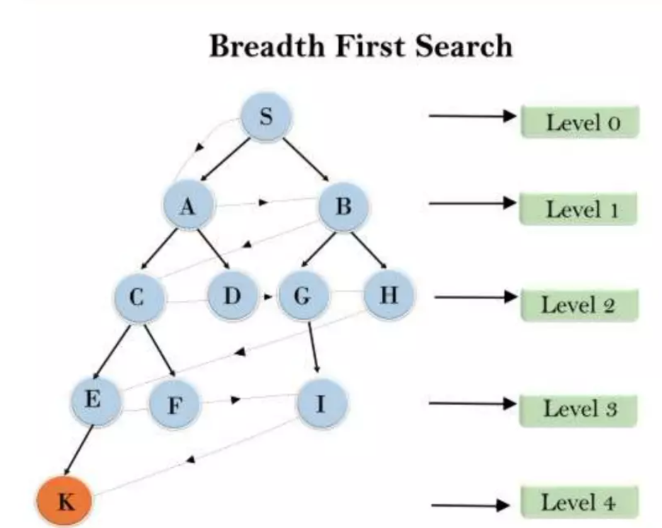

Slide 24
Advantages
Explores nodes level by level without missing any.
Easy to understand and implement with a queue.
Always finds the shortest path in unweighted graphs.
Disadvantage
It requires lots of memory since each level of the tree must be saved into memory to expand the next level.
BFS needs lots of time if the solution is far away from the root node.

Slide 25
Depth-first search
Depth-first search is a recursive algorithm for traversing a tree or graph data structure.
It is called depth-first search because it starts from root node and follows each path to its greatest depth node before moving to the next path.
DFS uses a stack data structure for its implementation.
The process of DFS algorithm is similar to the BFS algorithm.
Backtracks when no further successors are available.

Slide 26
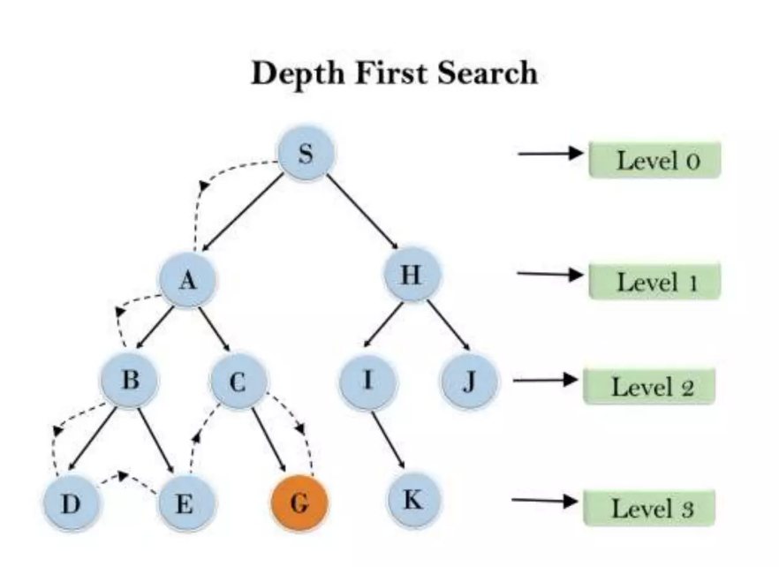

Slide 27
Advantage
Requires very less memory.
Easy to implement using recursion or stack.
Suitable for deep search problems.
Disadvantage
Not guaranteed to find the optimal solution.
Can get trapped in an infinite path.

Slide 28
Greedy Best-first search
Greedy best-first search is an informed(heuristic) search algorithm
It selects the node that appears closest to the goal.
It uses the evaluation function f(n)= h(n)
The node with the lowest heuristic value is expanded first.
It can find a solution quickly but does not guarantee the optimal path.

Slide 29
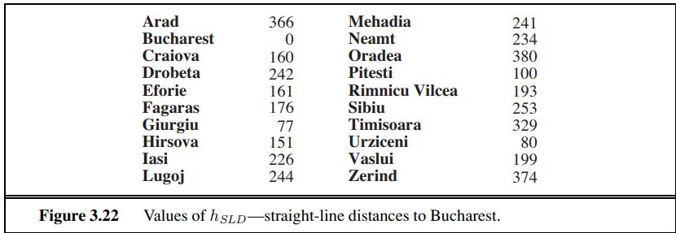

Slide 30
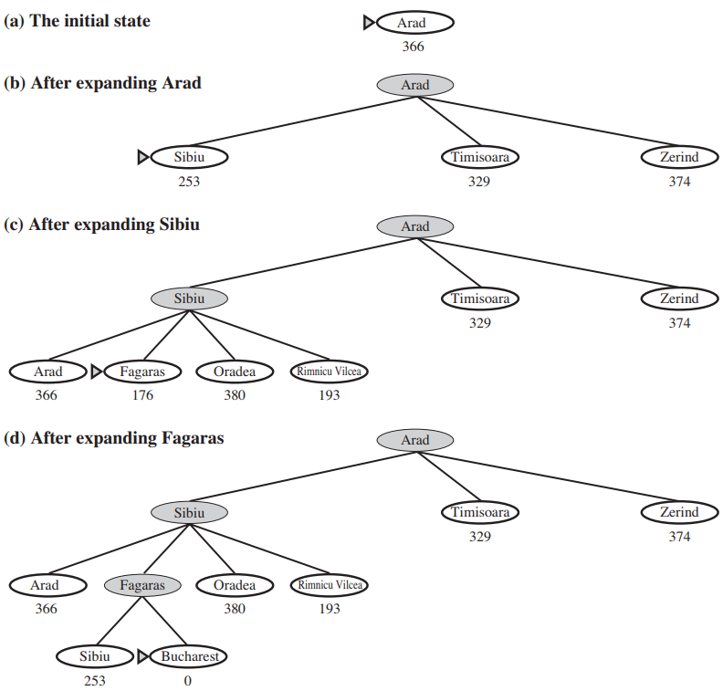

Slide 31
Advantage
Uses heuristic knowledge to guide the search.
Can reach the goal quickly when the heuristic is good.
Often explores fewer nodes than uninformed search methods.
Disadvantage
Does not guarantee the shortest/optimal path.
Can make a wrong choice because it only considers the estimated distance to the goal.
Can get stuck in an infinite path.

Slide 32
A* Algorithm
A* is an informed (heuristic) search algorithm that combines the actual cost to reach a node and the estimated cost to the goal.
It uses the evaluation function: f(n) = g(n) + h(n).
Where g(n) = actual cost from the start node to node n.
h(n) = estimated cost from node n to the goal.
The node with the lowest f(n) value is expanded first.
With an admissible heuristic (and appropriate graph-search conditions), A* is complete and optimal.

Slide 33
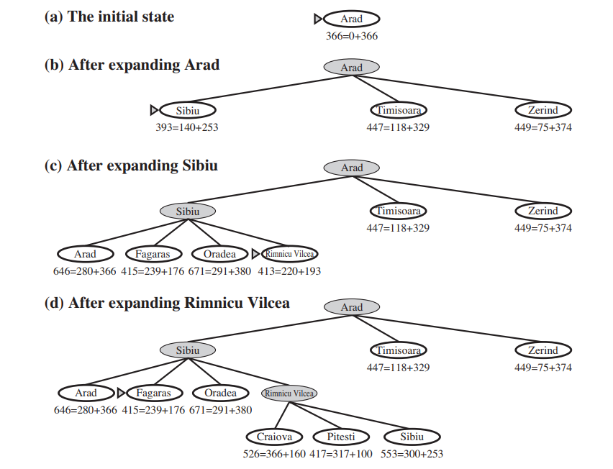

Slide 34
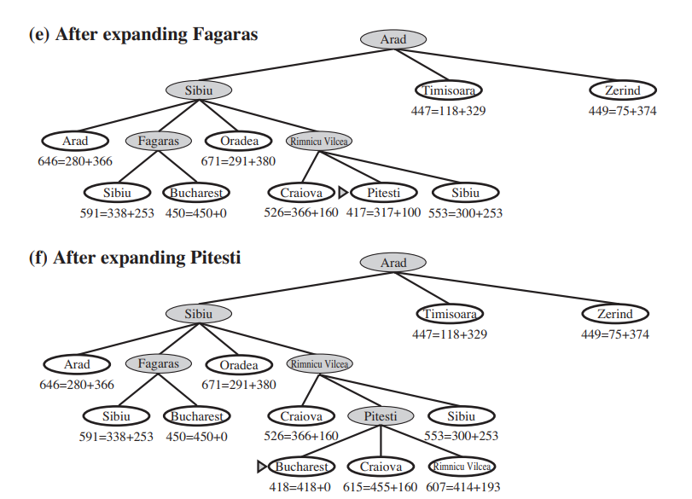

Slide 35
Advantage
Finds the optimal/shortest path when the heuristic is admissible.
Uses both actual cost and estimated cost: f(n) = g(n) + h(n).
A good heuristic makes the search faster and more efficient.
Disadvantage
Requires high memory because it stores many generated nodes.
Can be time-consuming for large search spaces.
Performance depends heavily on the quality of the heuristic.

Slide 36
AO* Algorithm
AO* is an informed search algorithm used to find optimal solutions in AND-OR graphs.
It is an extension of the A* algorithm that can handle more complex decision structures.
Unlike A* which generally selects one optimal path, AO* can select multiple subproblems that are connected through AND nodes.
It uses heuristic information to estimate costs and guide the search efficiently.

Slide 37
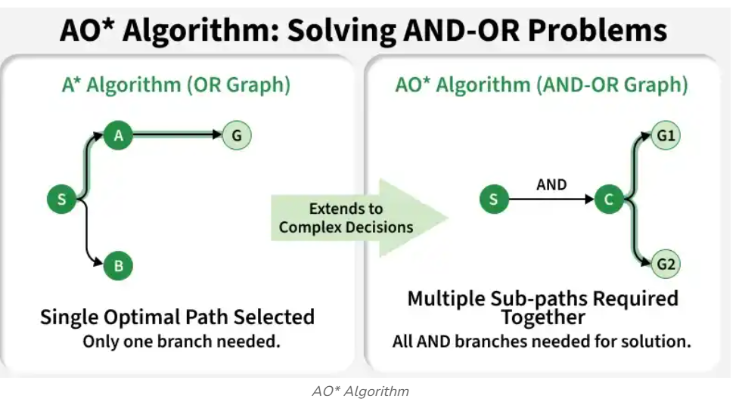

Slide 38
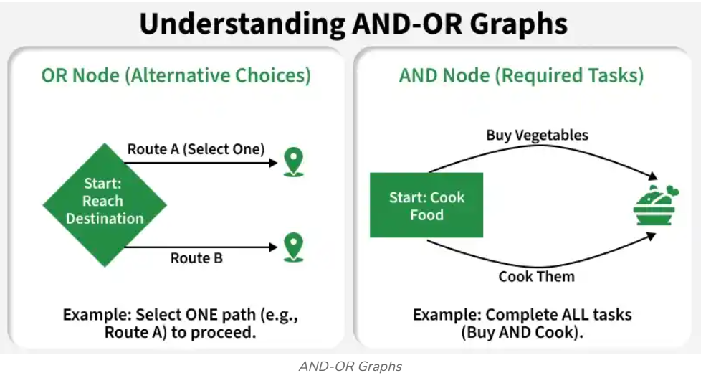

Slide 39
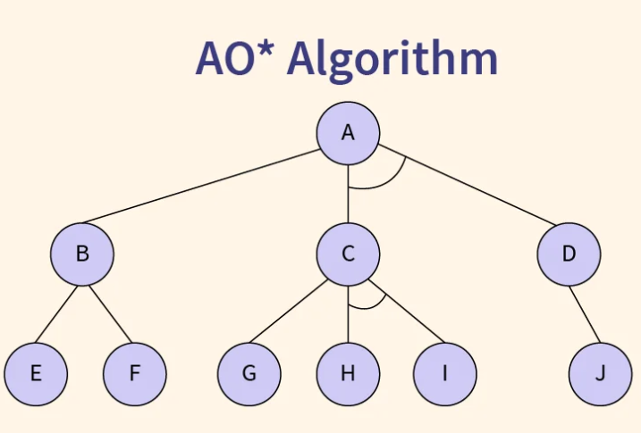

Slide 40
Advantages
Efficient for complex AND OR problems
Avoids exploring unnecessary branches
Suitable for problem reduction approaches
Limitations
Requires a good heuristic for better performance
Implementation is more complex than A Star
Can consume high memory for large graphs

Slide 41
Hill Climbing Algorithm
Hill Climbing is a heuristic search algorithm used to find an optimal or near-optimal solution by repeatedly moving from the current state to a better neighboring state based on an evaluation function.
Used to solve various optimization and search problems in AI.
Improves the current solution by making small changes and evaluating them.
Its simple logic makes it easy to implement and adapt to different problems.

Slide 42
Types of Hill Climbing Search
Simple Hill Climbing Algorithm
Steepest-Ascent Hill Climbing
Stochastic Hill Climbing

Slide 43
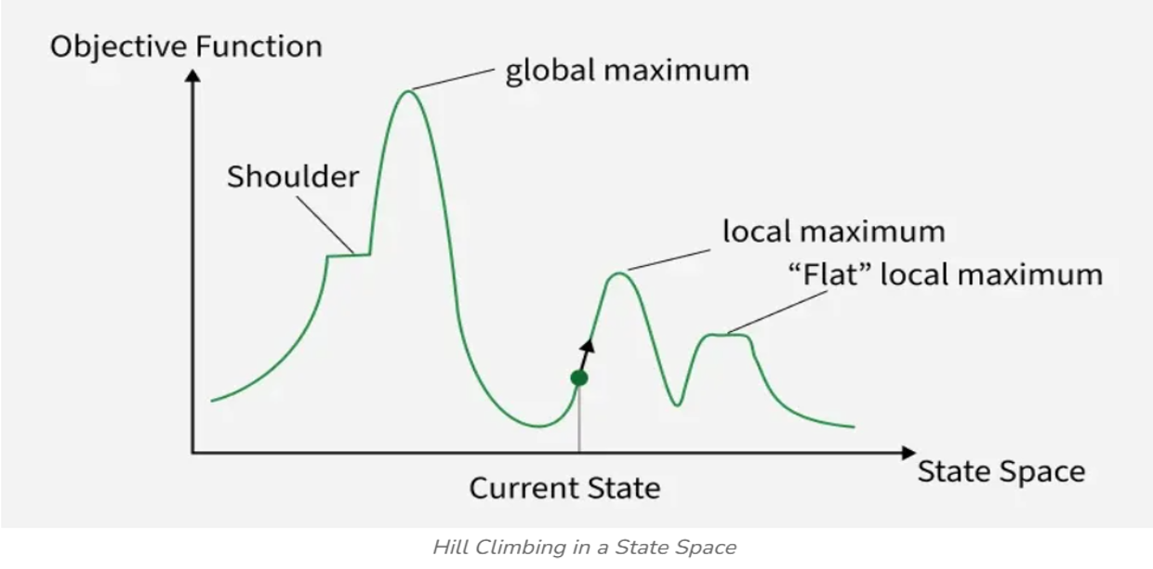
Visual representation

Slide 44
Local Maximum: A state better than its neighboring states but not the best overall solution.
Global Maximum: The state with the highest objective value in the entire search space.
Plateau: A flat region where neighboring states have similar or equal values.
Current State: The state where the algorithm is currently positioned during the search.
Shoulder: A flat region with an upward edge that can lead to a better solution.

Slide 45
Advantages
Uses less memory.
Finds a good solution quickly.
Easy to customize according to the problem.
Disadvantages
Can get stuck in a local optimum.
May get stuck on plateaus.
Difficult to handle ridges.
Depends on the initial state.

Slide 46
Knowledge Representation
Knowledge Representation is the process of storing and organizing real-world knowledge in a structured form that AI systems can understand.
It enables machines to reason, learn and make intelligent decisions.
Helps AI perform reasoning and problem-solving tasks.
Used in applications such as medical diagnosis, language understanding and expert systems.
Allows AI to effectively use stored knowledge and past experiences.

Slide 47
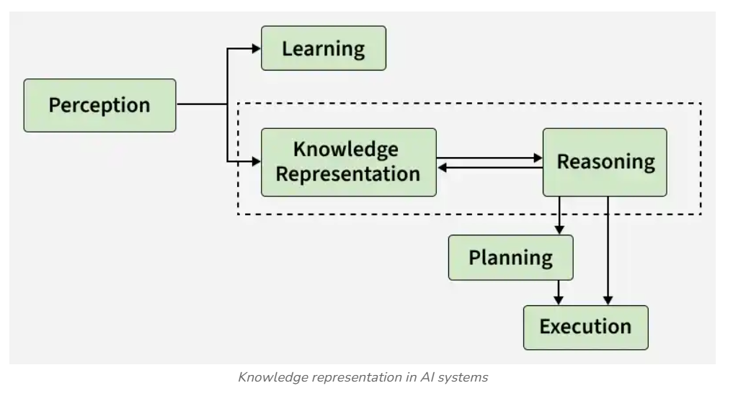

Slide 48
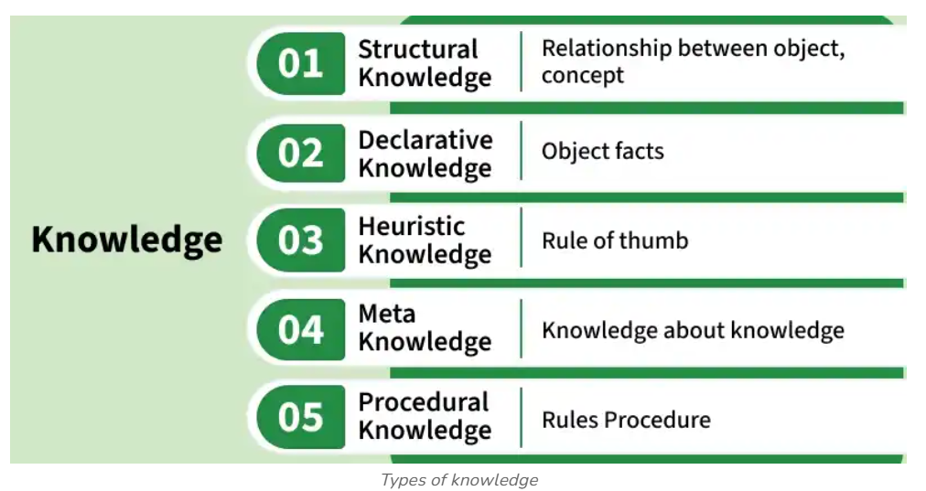

Slide 49
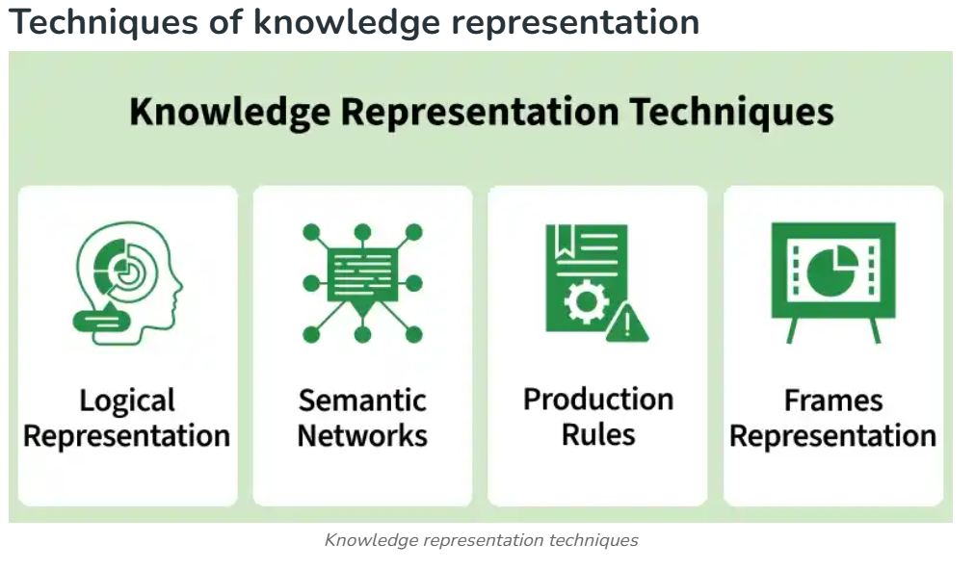

Slide 50
THANK YOU!

